Slide 1




Course name: EES
B.TECH FIRST YEAR
ACADemic YEAR: 2023-2024
Course : Electrical and ELECTRONICS SYSTEMS
lecture series no : 01 (one)
Credits : 4
Mode of delivery :
Faculty : ankur saharia
Email-id : ankur.saharia@jaipur.manipal.edu
PROPOSED DATE OF DELIVERY:

Slide 2
Bipolar Junction Transistors
The transistor is a three-layer semiconductor device consisting of either two n- and one p- type layers of material or two p- and one n- type layers of material.
The former is called an npn transistor, while the latter is called a pnp transistor
So, there are two types of BJT-
pnp transistor ii) npn transistor

Slide 3
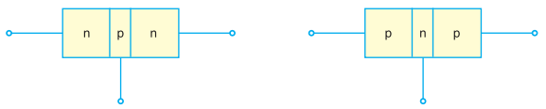
Bipolar Junction Transistors
In each transistor following points to be noted-
There are two junction, so transistor can be considered as two diode connected back to back.
There are three terminals.
The middle section is thin than other.

Slide 4
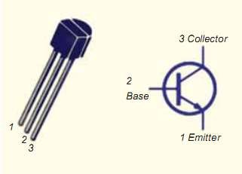
Naming of Transistor Terminals
Transistor has three section of doped semiconductor.
The section one side is called “emitter” and the opposite side is called “collector”.
The middle section is called “base”.
Transistor
symbol

Slide 5
Naming of Transistor Terminals
1) Emitter:
The section of one side that supplies carriers is called emitter.
Emitter is always forward biased wr to base so it can supply carrier.
For “npn transistor” emitter supply holes to its junction.
For “pnp transistor” emitter supply electrons to its junction.

Slide 6
Naming of Transistor Terminals
2) Collector:
The section on the other side that collects carrier is called collector.
The collector is always reversed biased wr to base.
For “npn transistor” collector receives holes to its junction.
For “pnp transistor” collector receives electrons to its junction.

Slide 7
Naming of Transistor Terminals
3) Base:
The middle section which forms two pn junction between emitter and collector is called Base.

Slide 8
Some important factors to be remembered-
The transistor has three region named emitter, base and collector.
The Base is much thinner than other region.
Emitter is heavily doped so it can inject large amount of carriers into the base.
Base is lightly doped so it can pass most of the carrier to the collector.
Collector is moderately doped.

Slide 9
Some important factors to be remembered-
The junction between emitter and base is called emitter-base junction(emitter diode) and junction between base and collector is called collector-base junction(collector diode).
The emitter diode is always forward biased and collector diode is reverse biased.
The resistance of emitter diode is very small (forward) and resistance of collector diode is high (reverse).

